Slide 1

scraping cats
Wendy Chau
May 2019

Slide 2
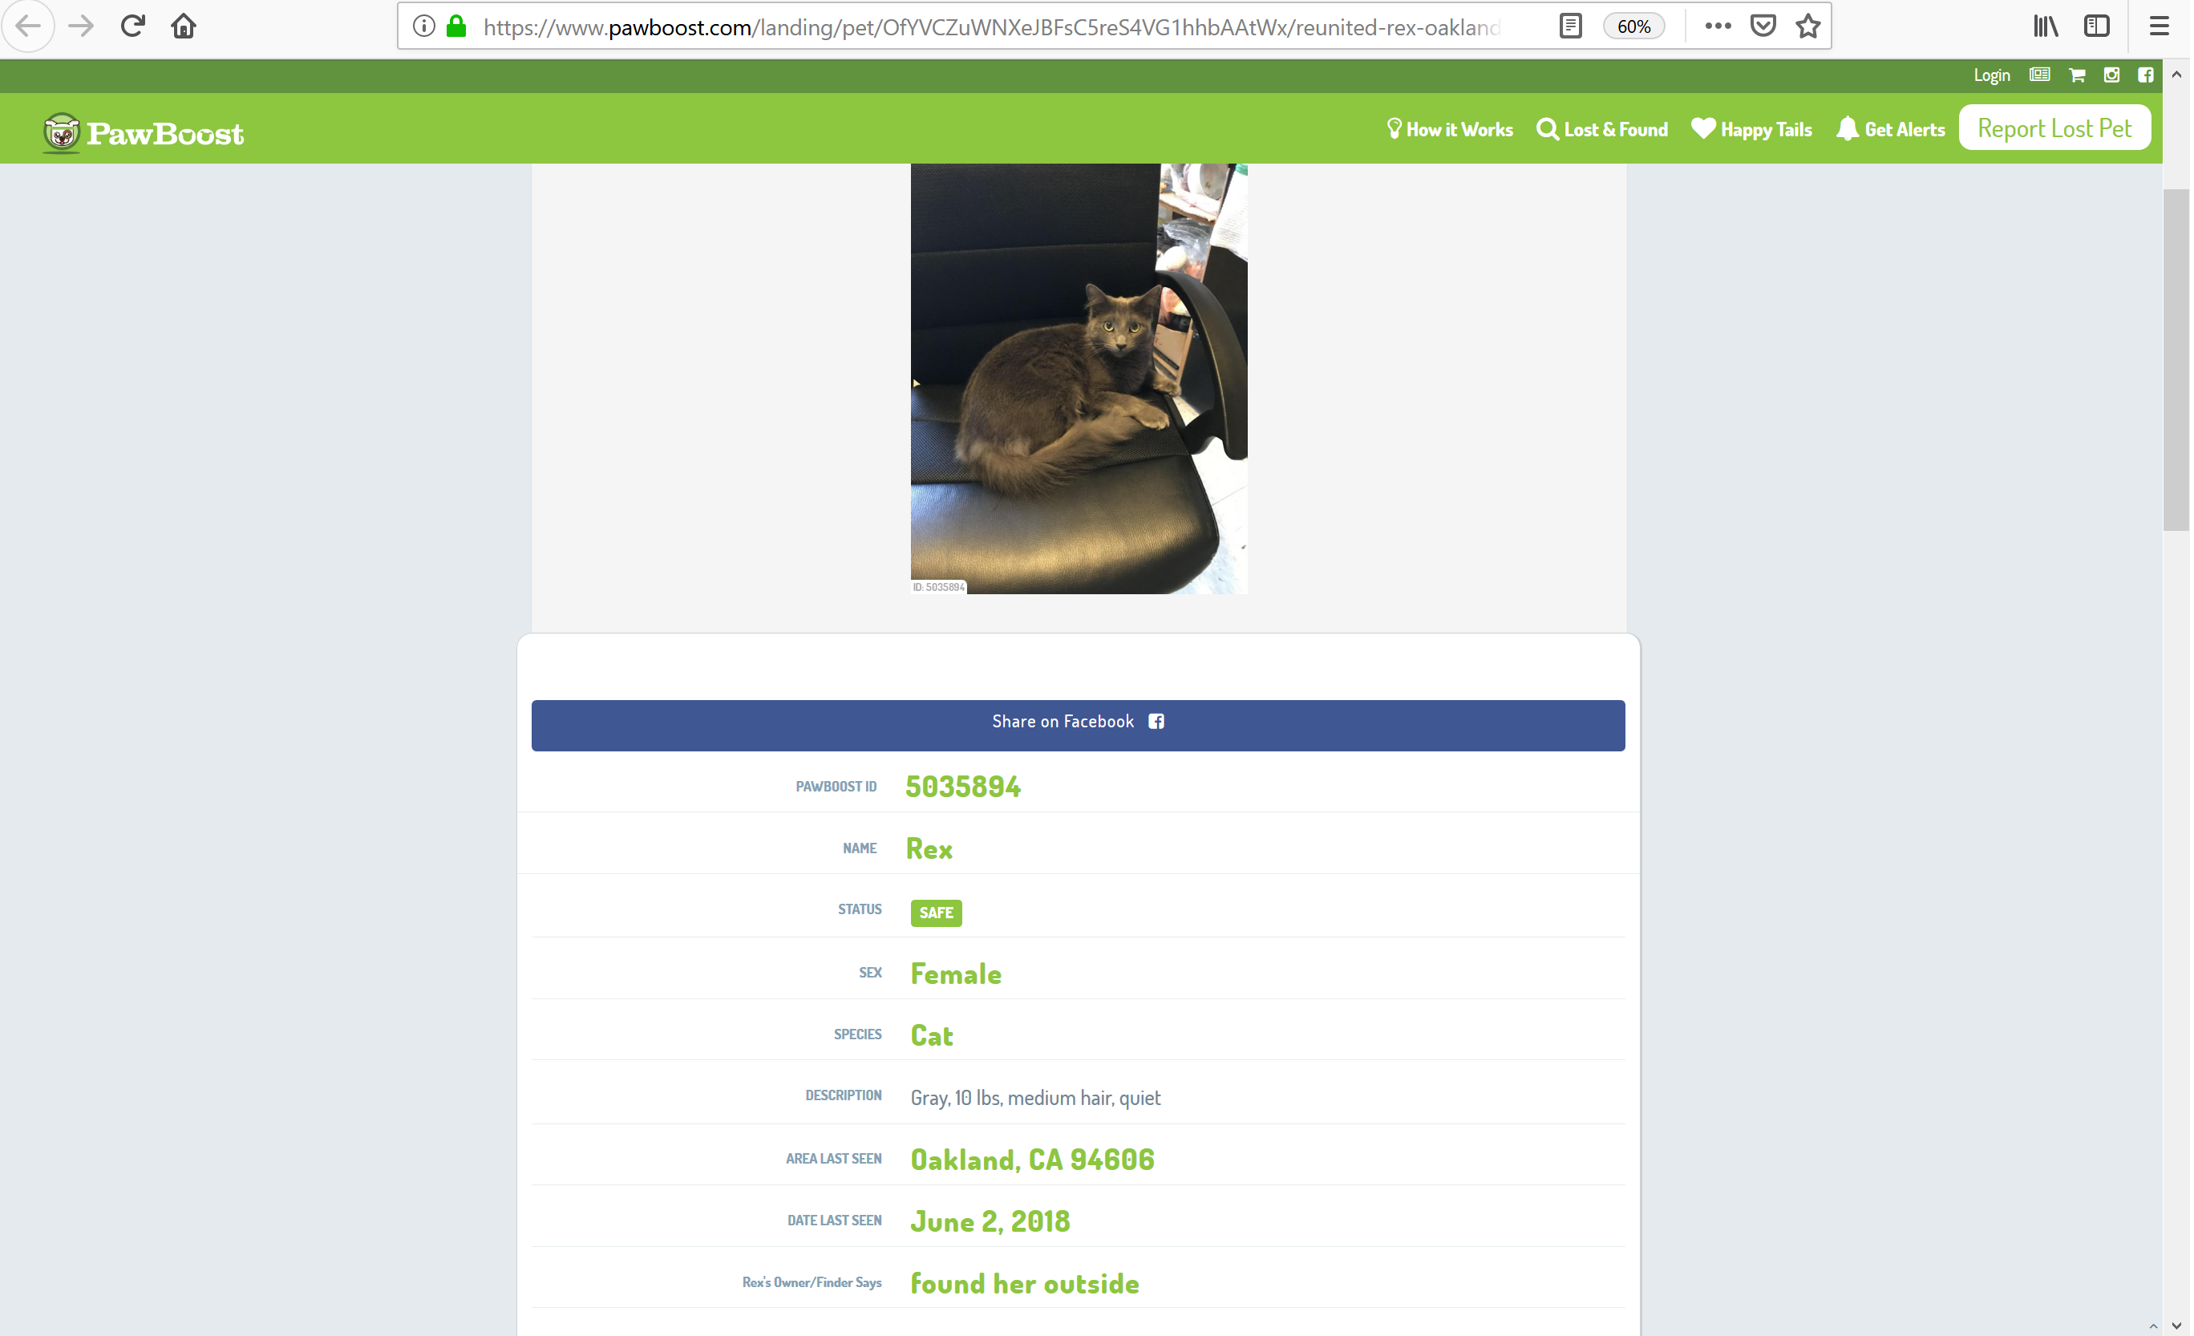
BACKSTORY!
She ran away when I was on vacation ☹
< data

Slide 3
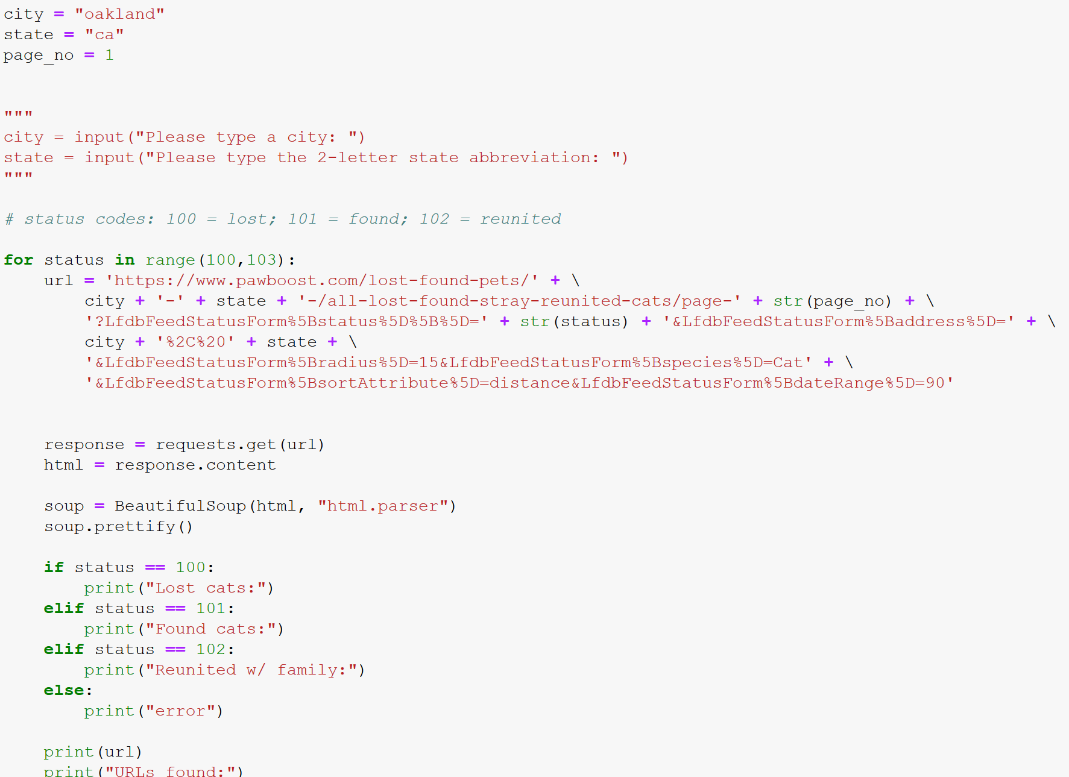
< can change fields to other locations
< ~20 results per page
SCRAPER
Pulling listings from search results from last 90 days & loop through status codes
^ can search for dogs too, change distance, age of listing, etc;

Slide 4
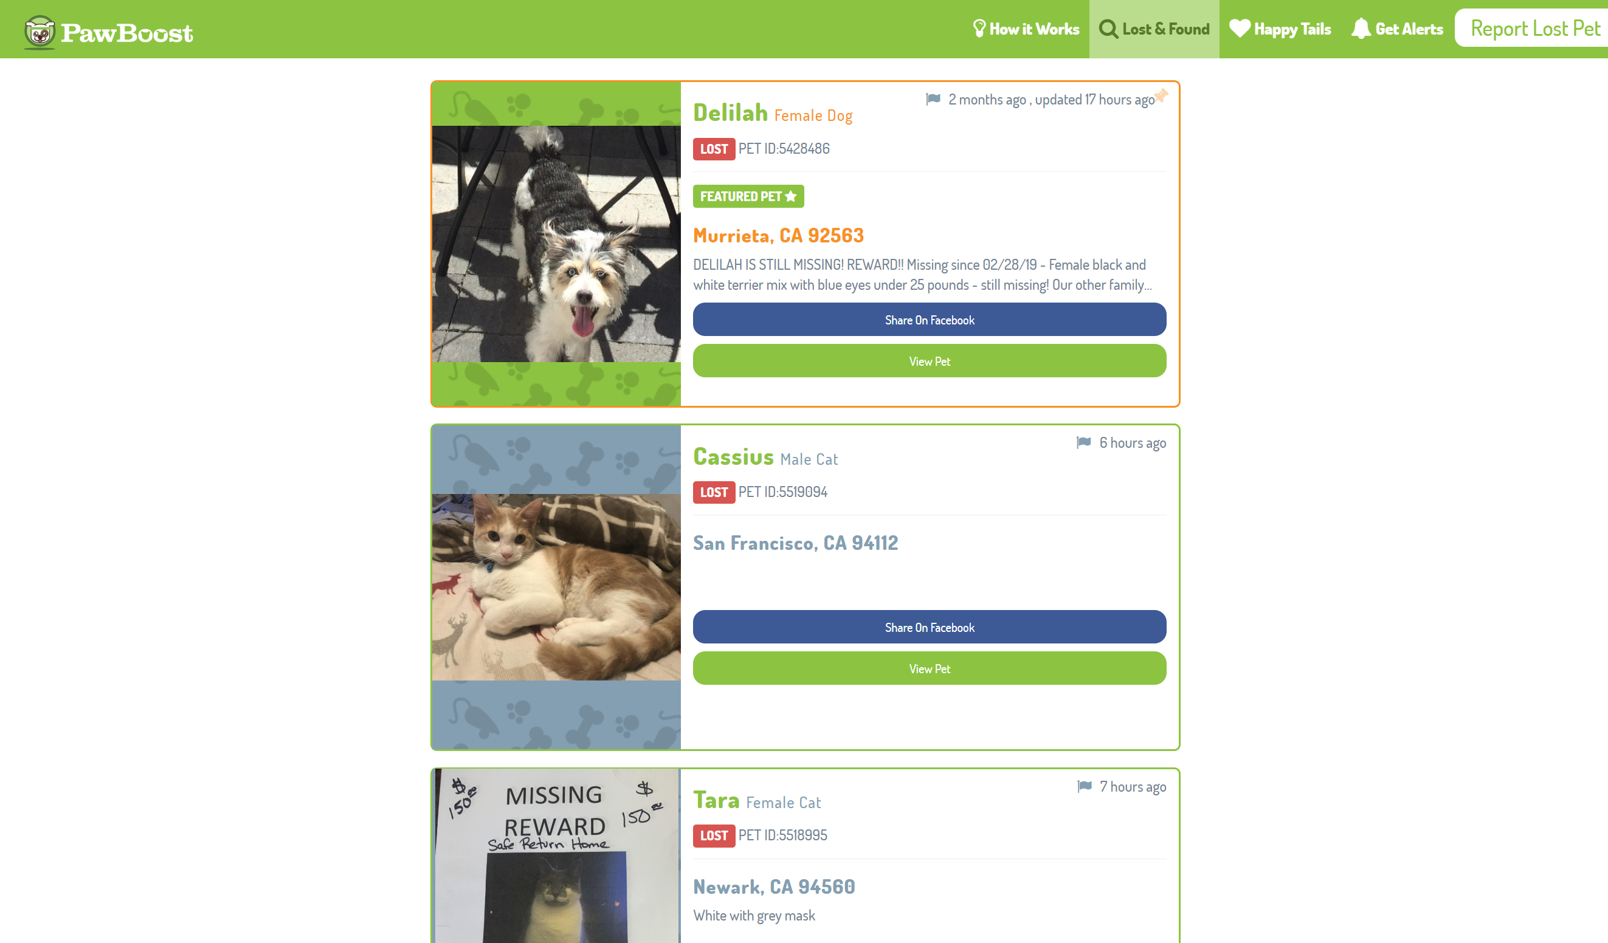
< 448 miles away,
plus not a cat!
< URL
< URL

Slide 5
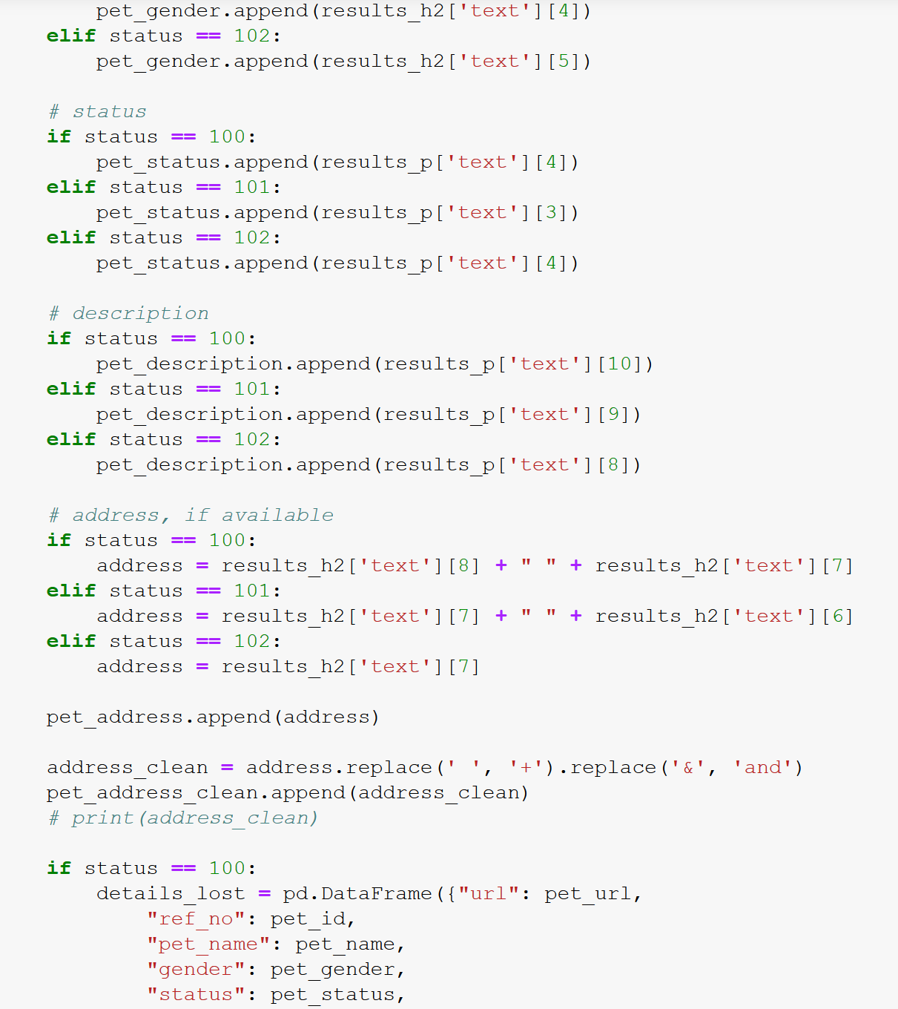
depending on the type of listing, certain elements are missing / appear out of place, e.g. no personal info or cross streets for cats already reunited
cleaning up cross-streets / neighborhoods to convert to coordinates

Slide 6
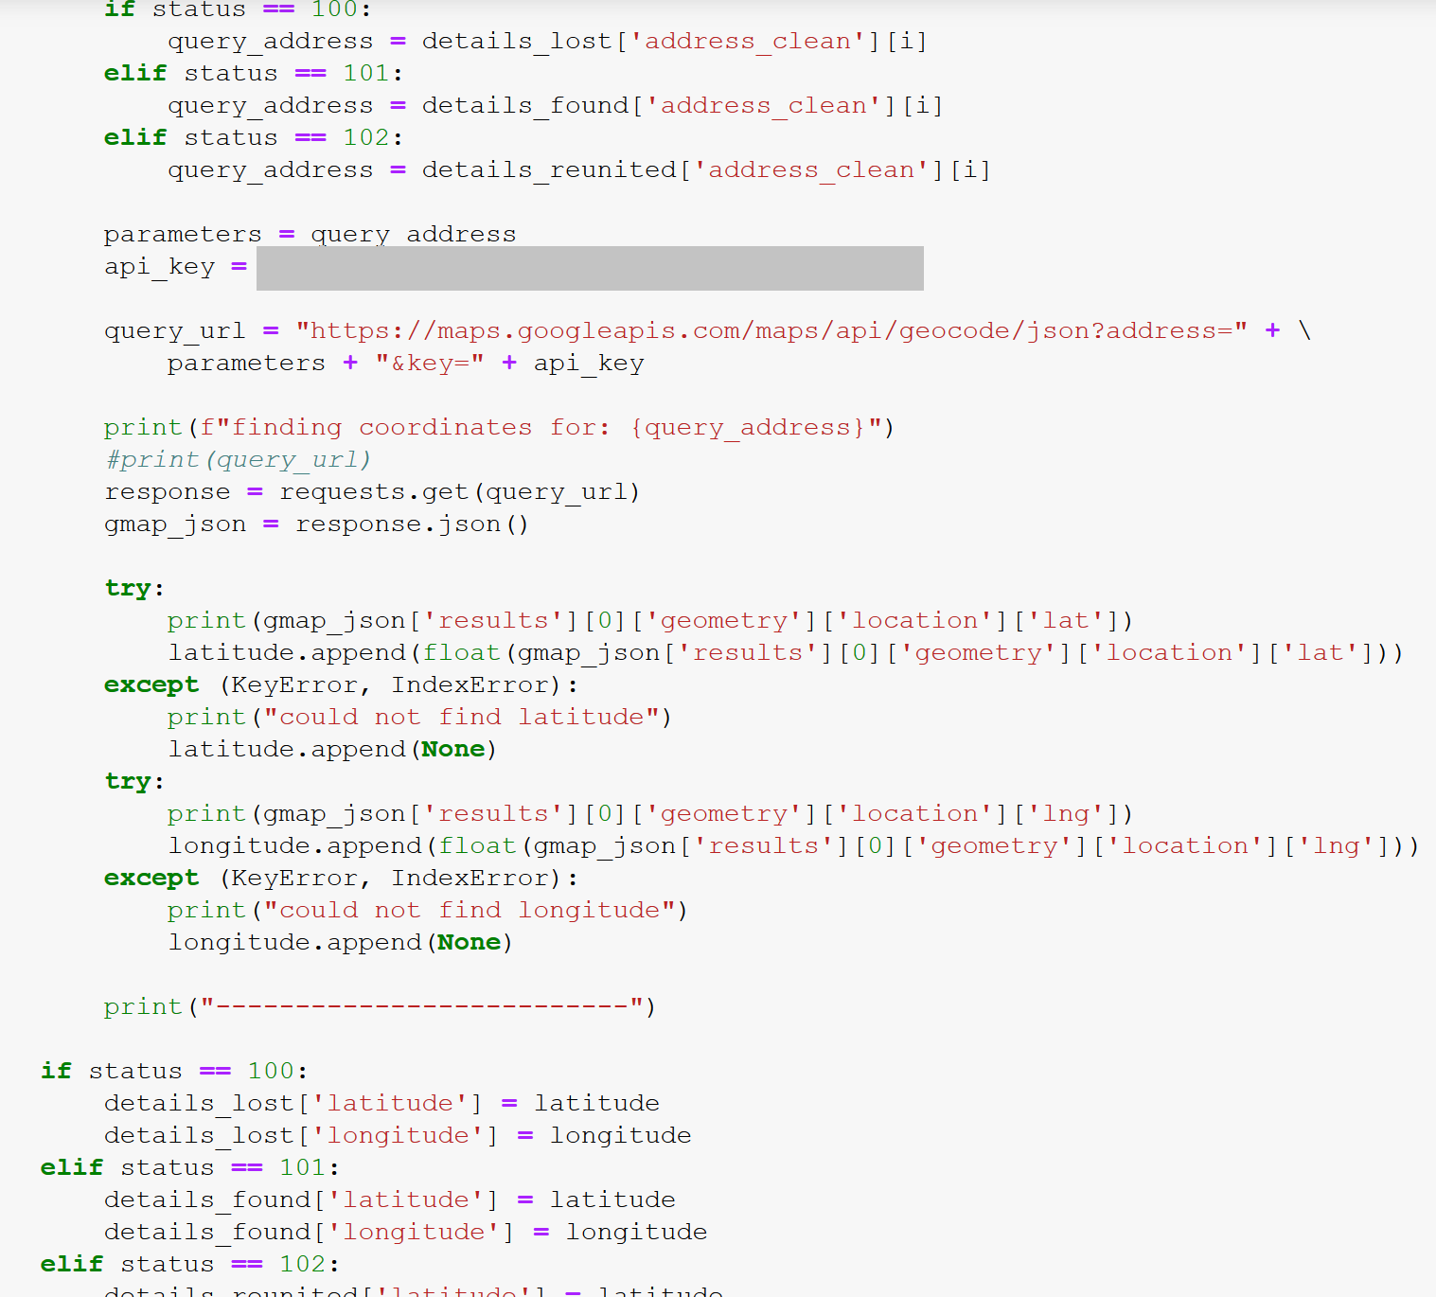
Getting coordinates from Google API

Slide 7
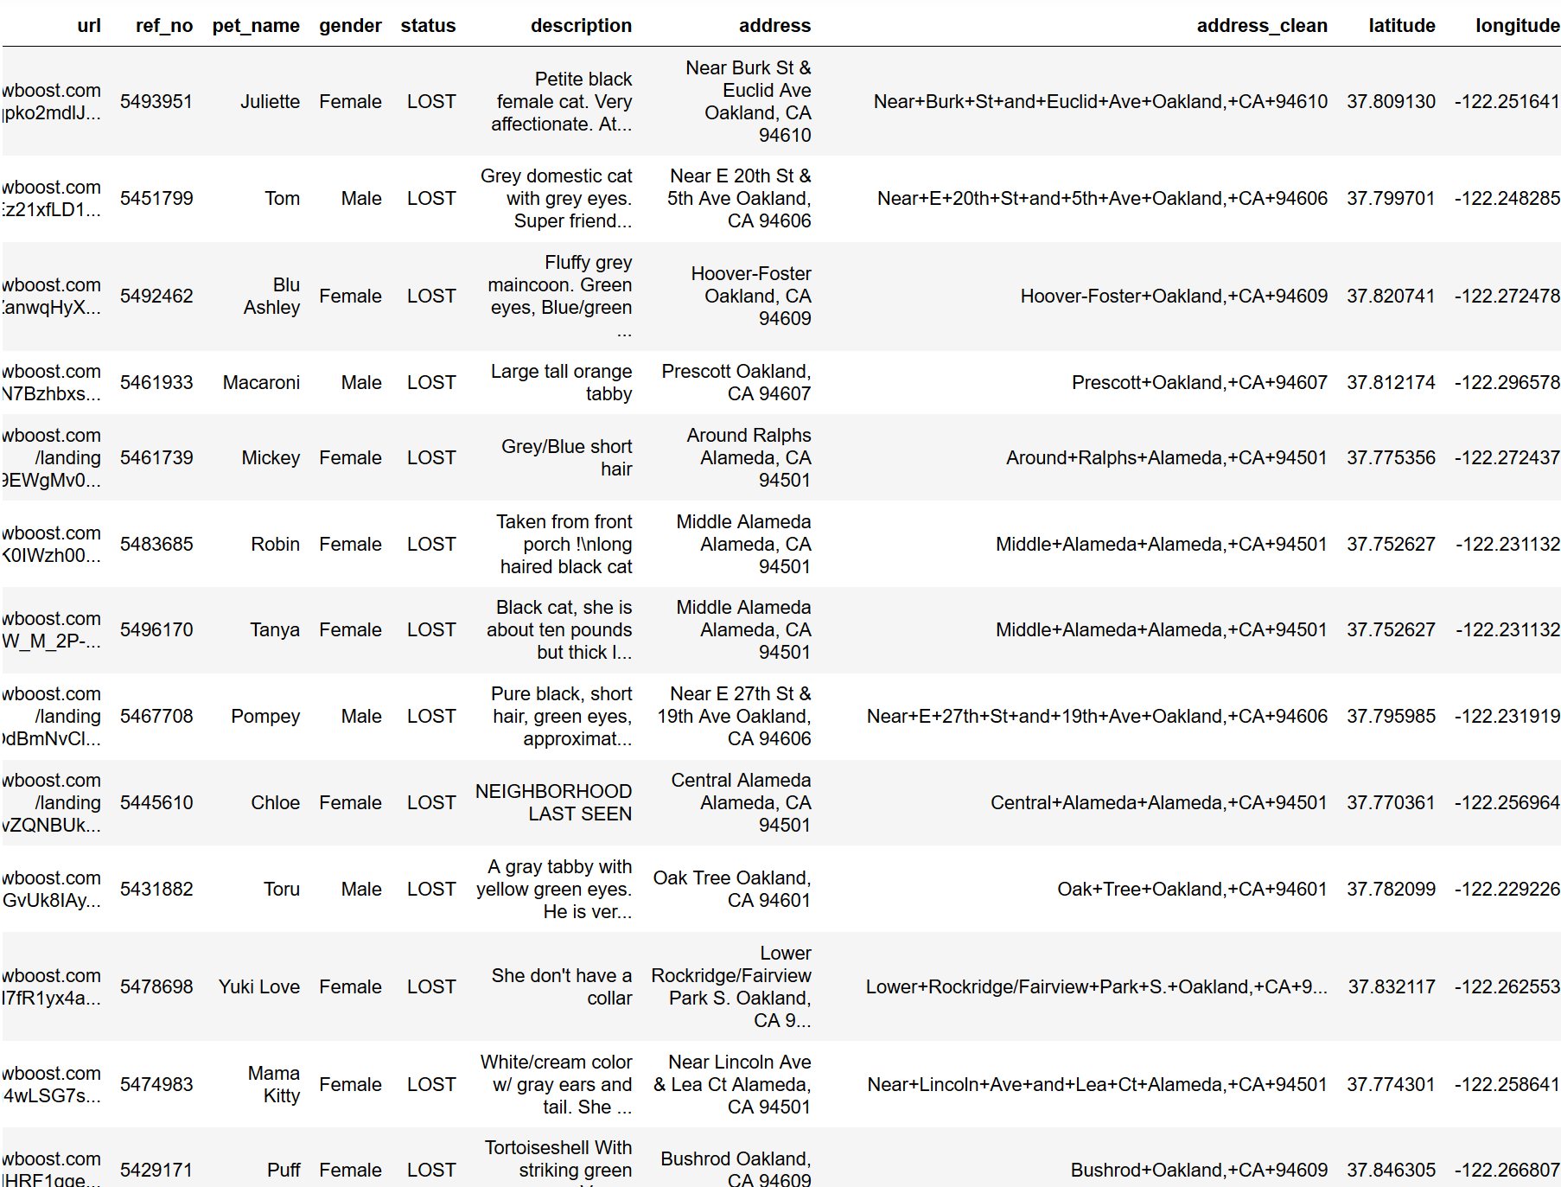
< sample of results
Descriptions were dirty, had to assign color
Exported to CSV

Slide 8
Tools:
Beautiful Soup, pgAdmin, flask app, geoJSON, vue JS
dashboard with:
leaflet map
d3 word cloud
scatterplot
Sources:
Pawboost.com (lost pet directory)
Google API
Jason Davies’ word cloud

Slide 9
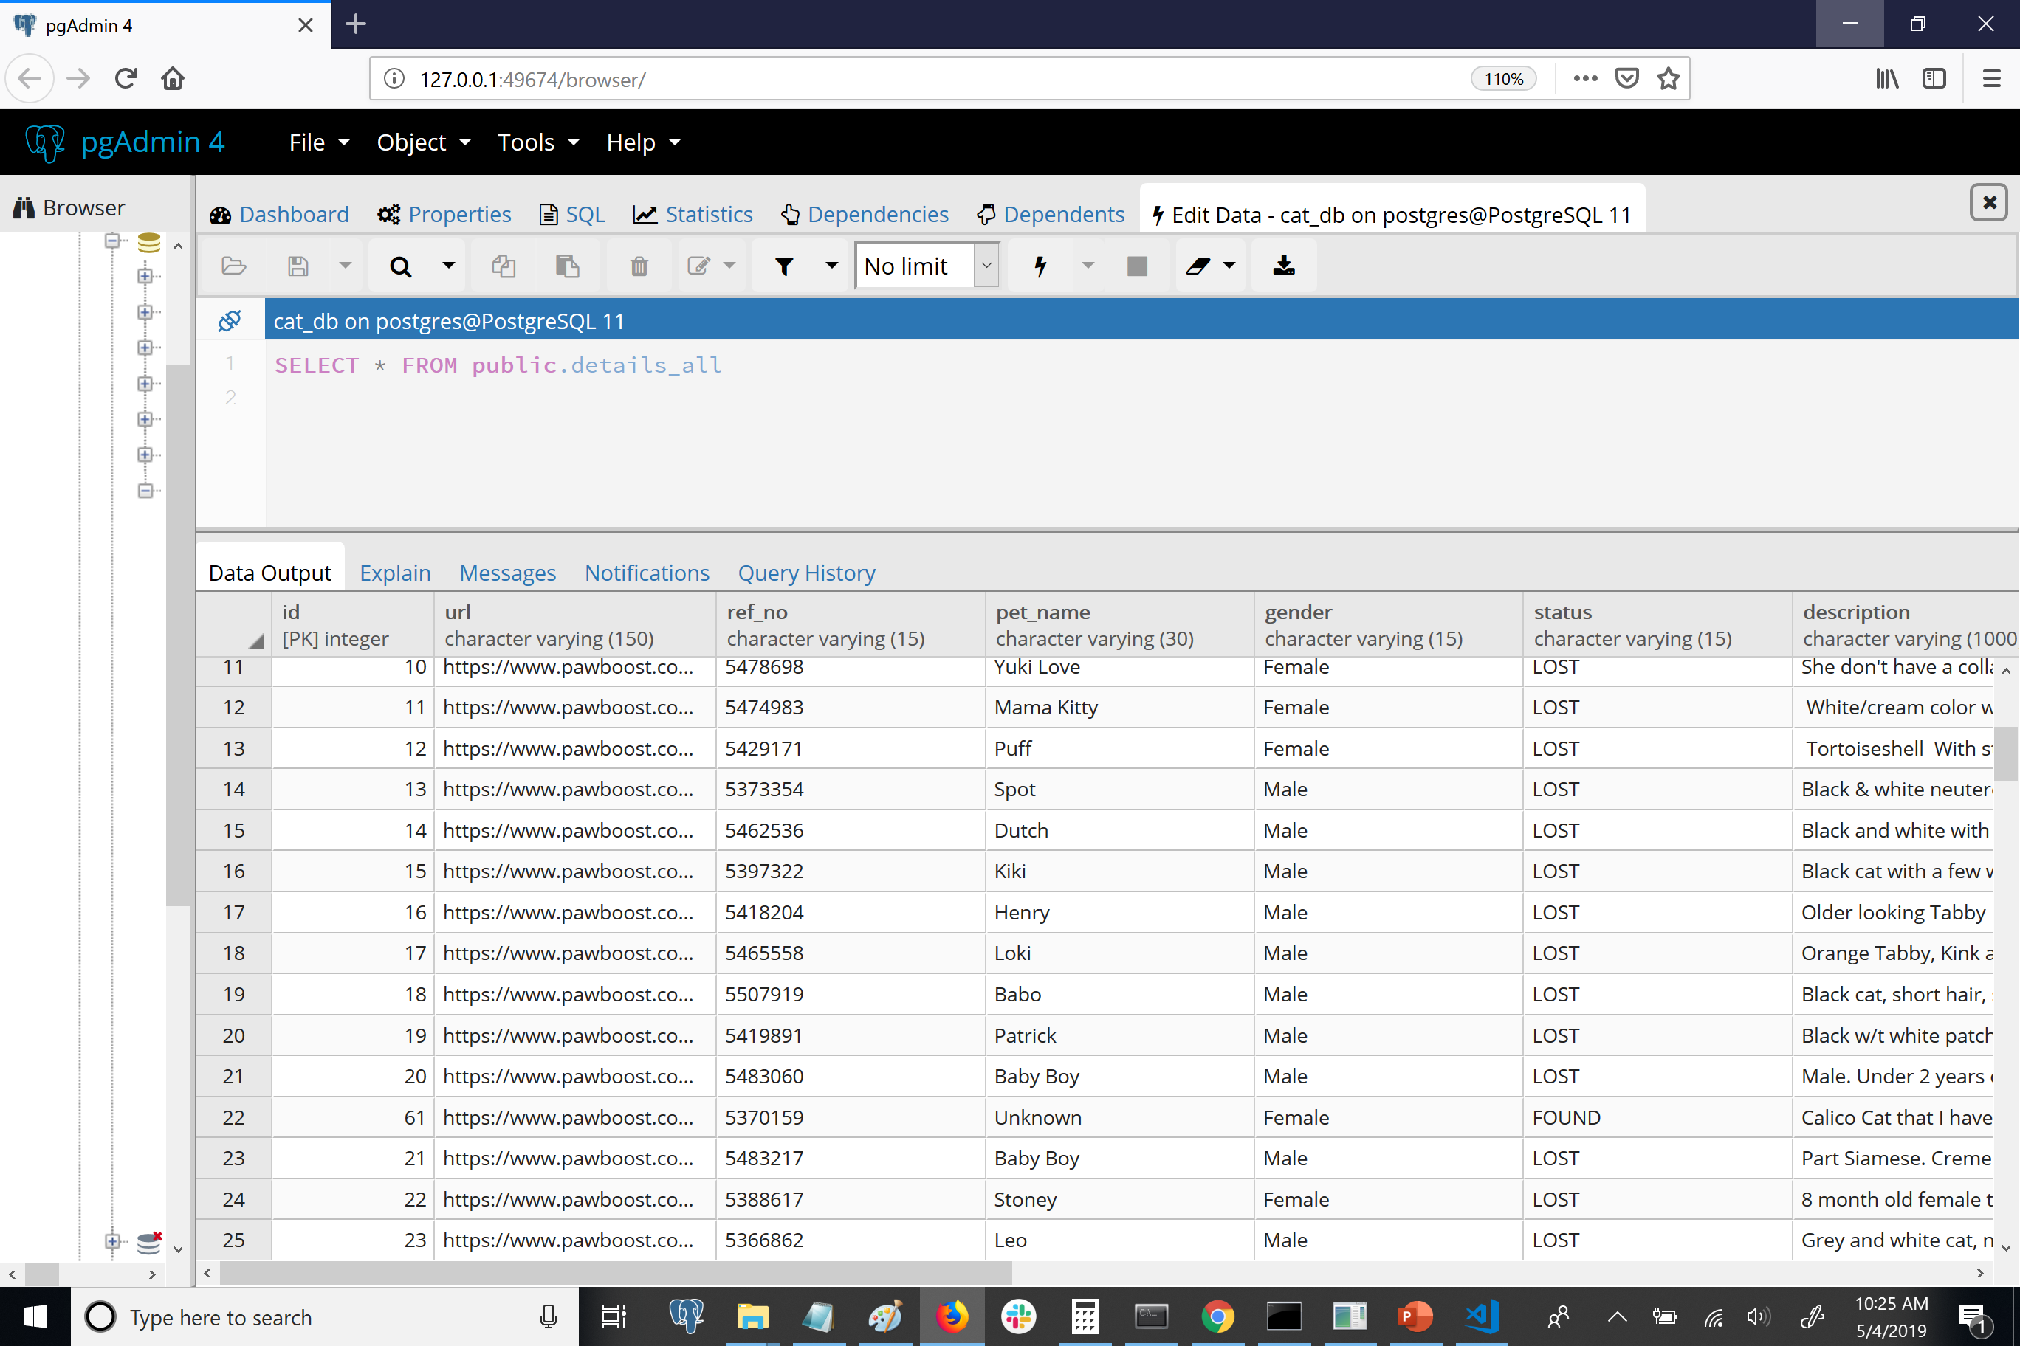

Slide 10
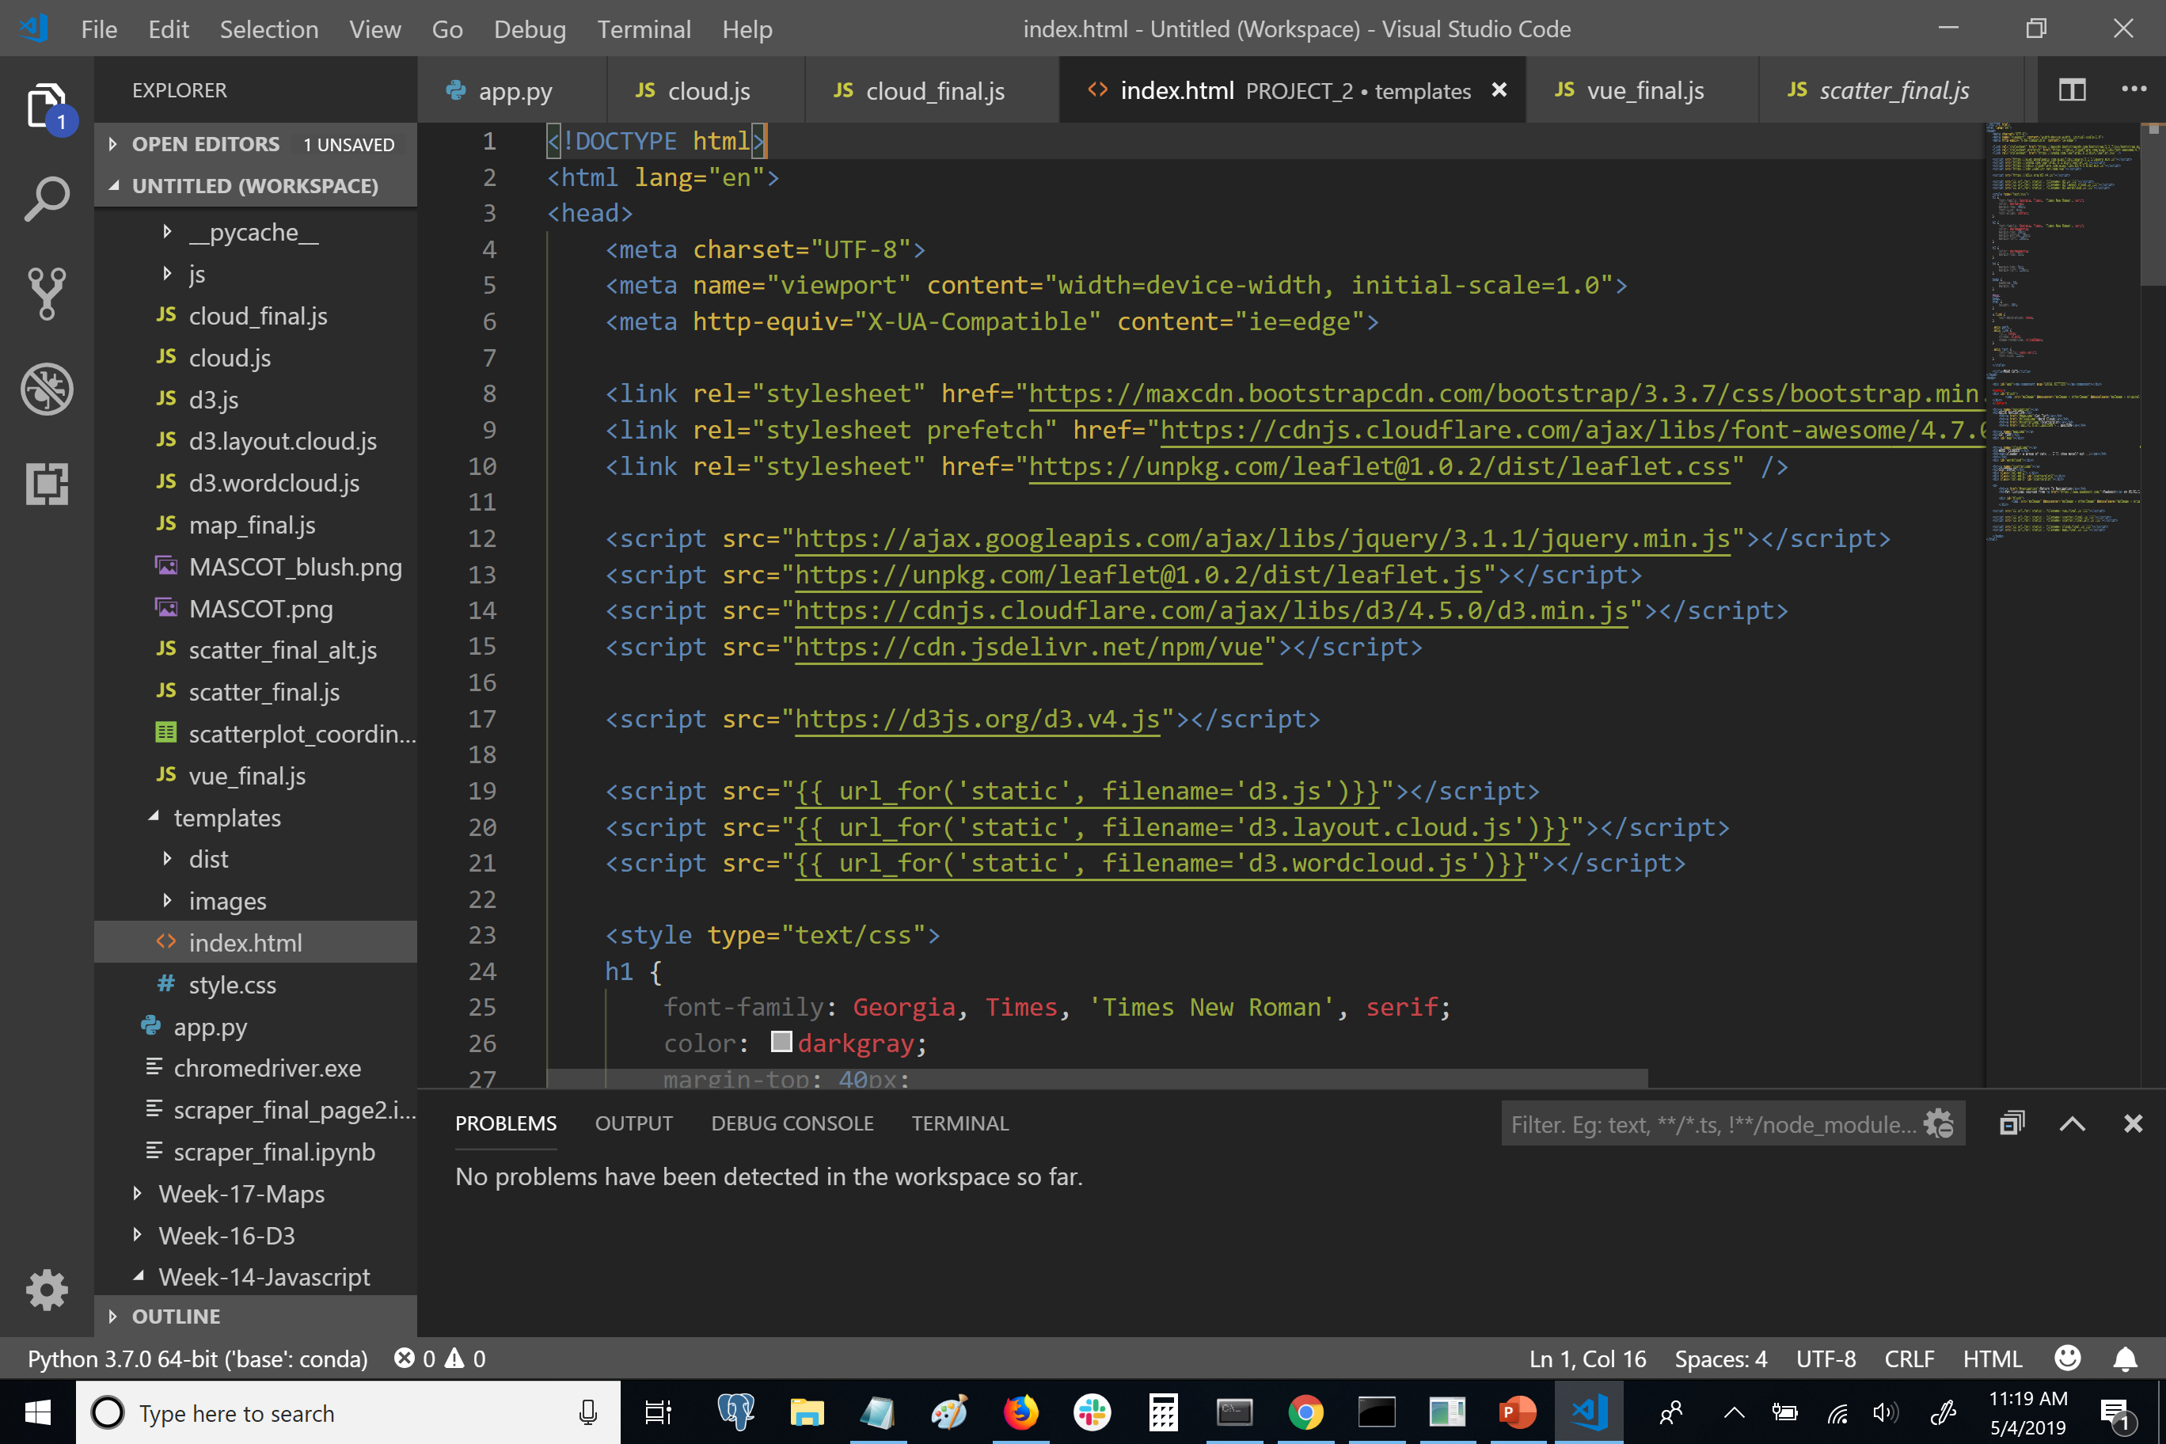


Slide 11
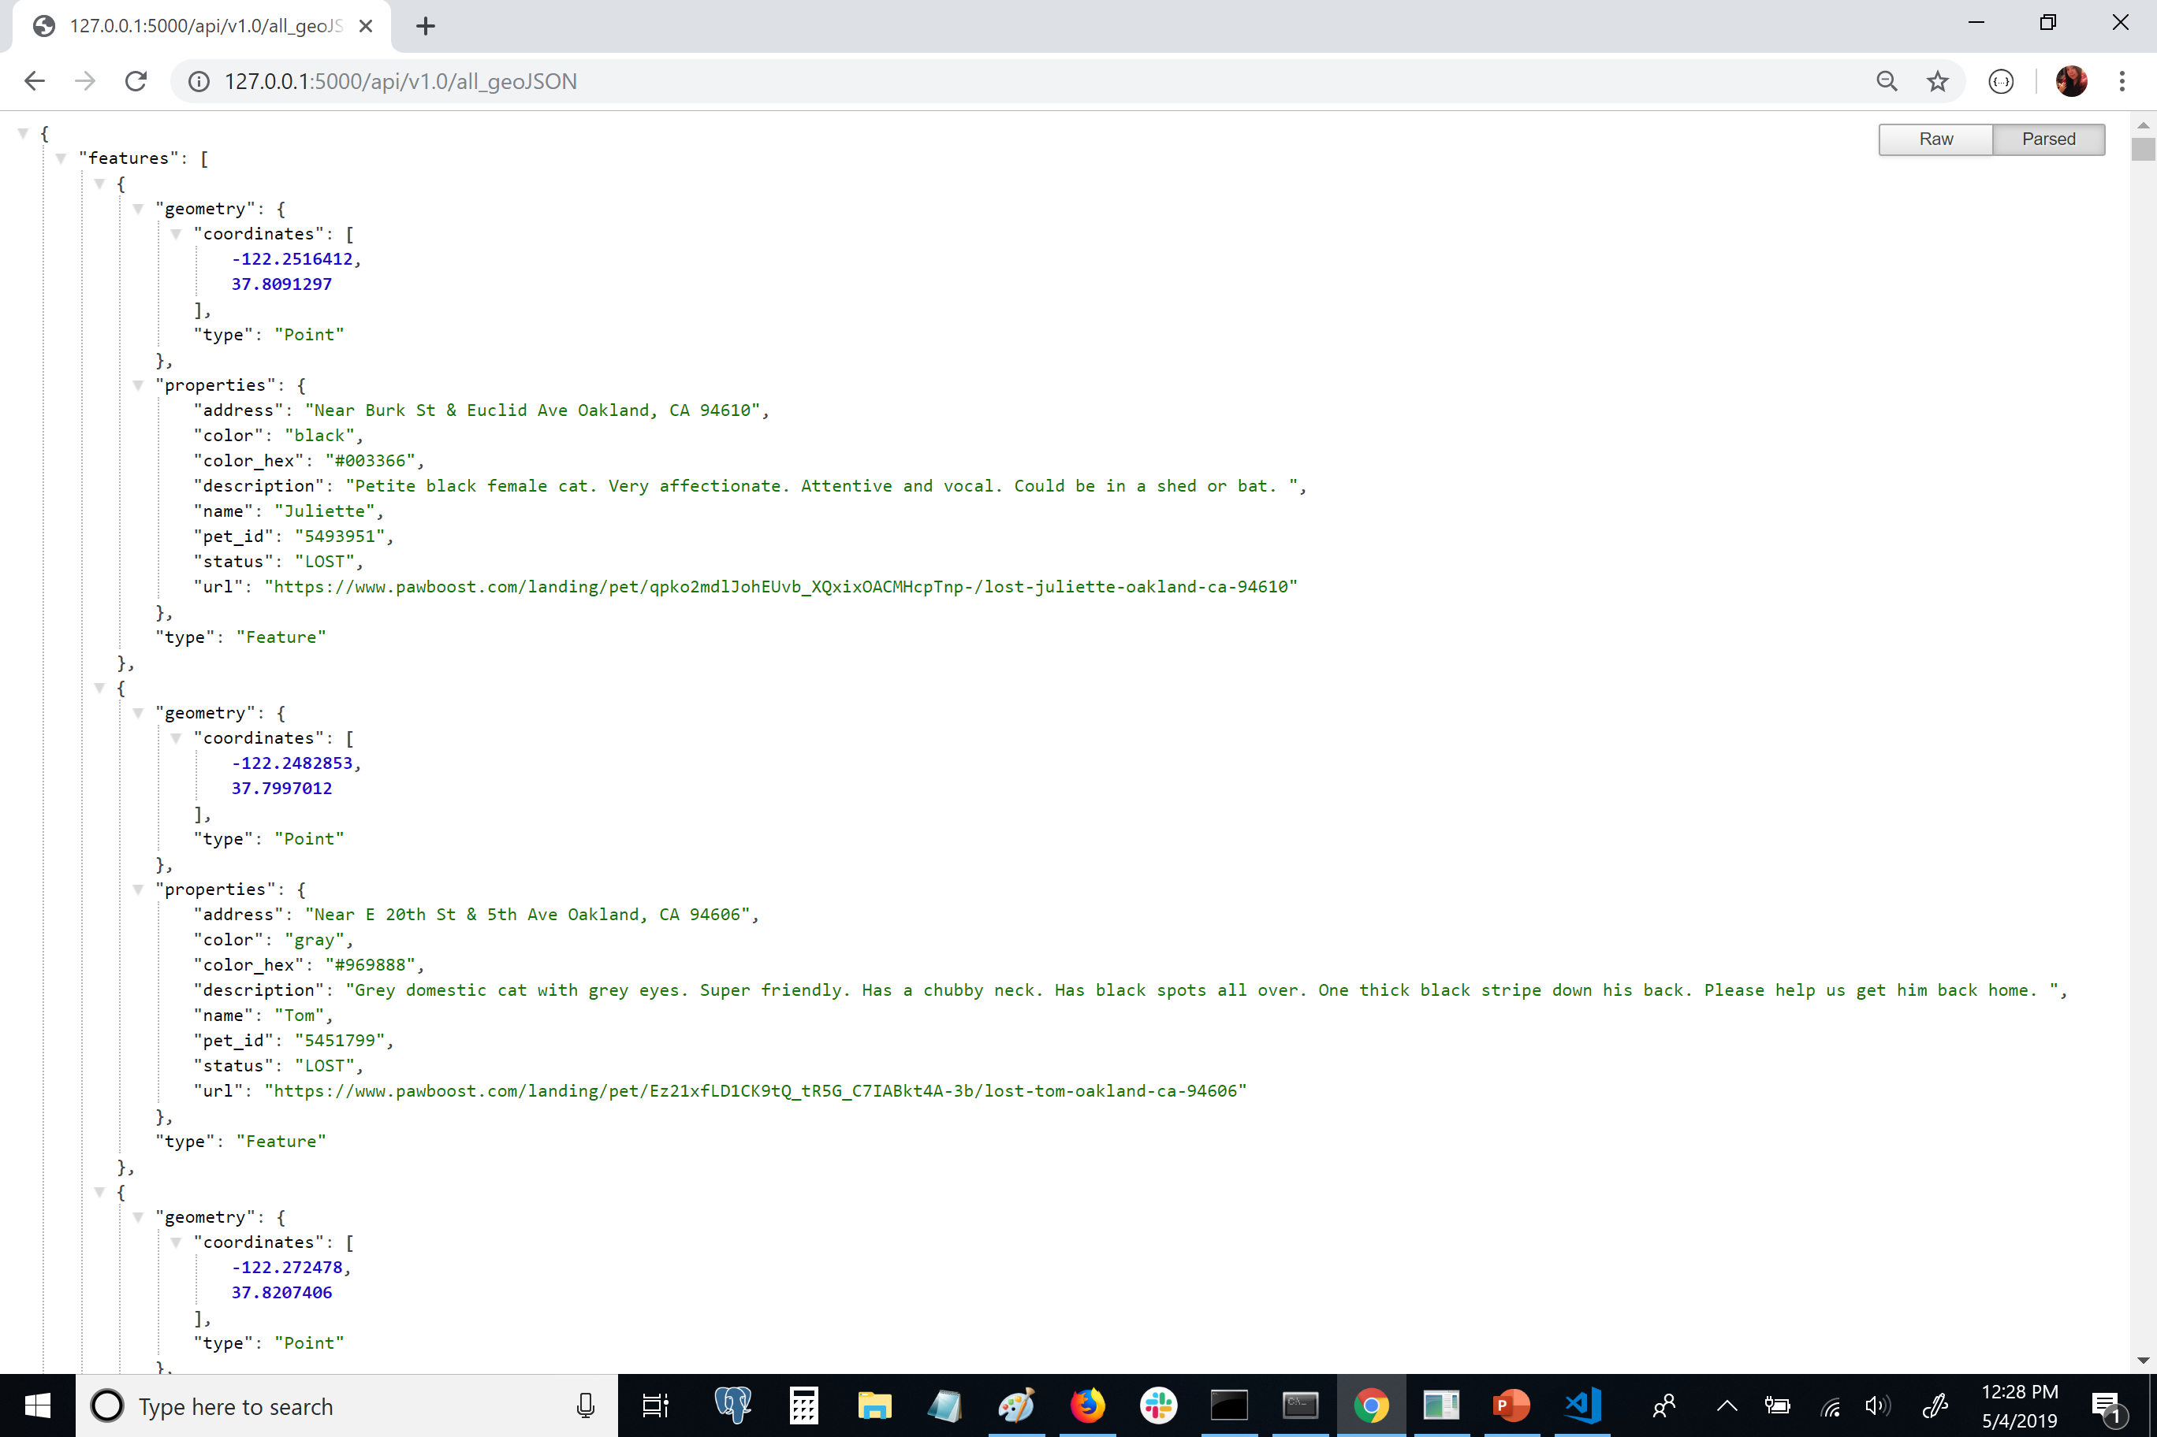

Slide 12
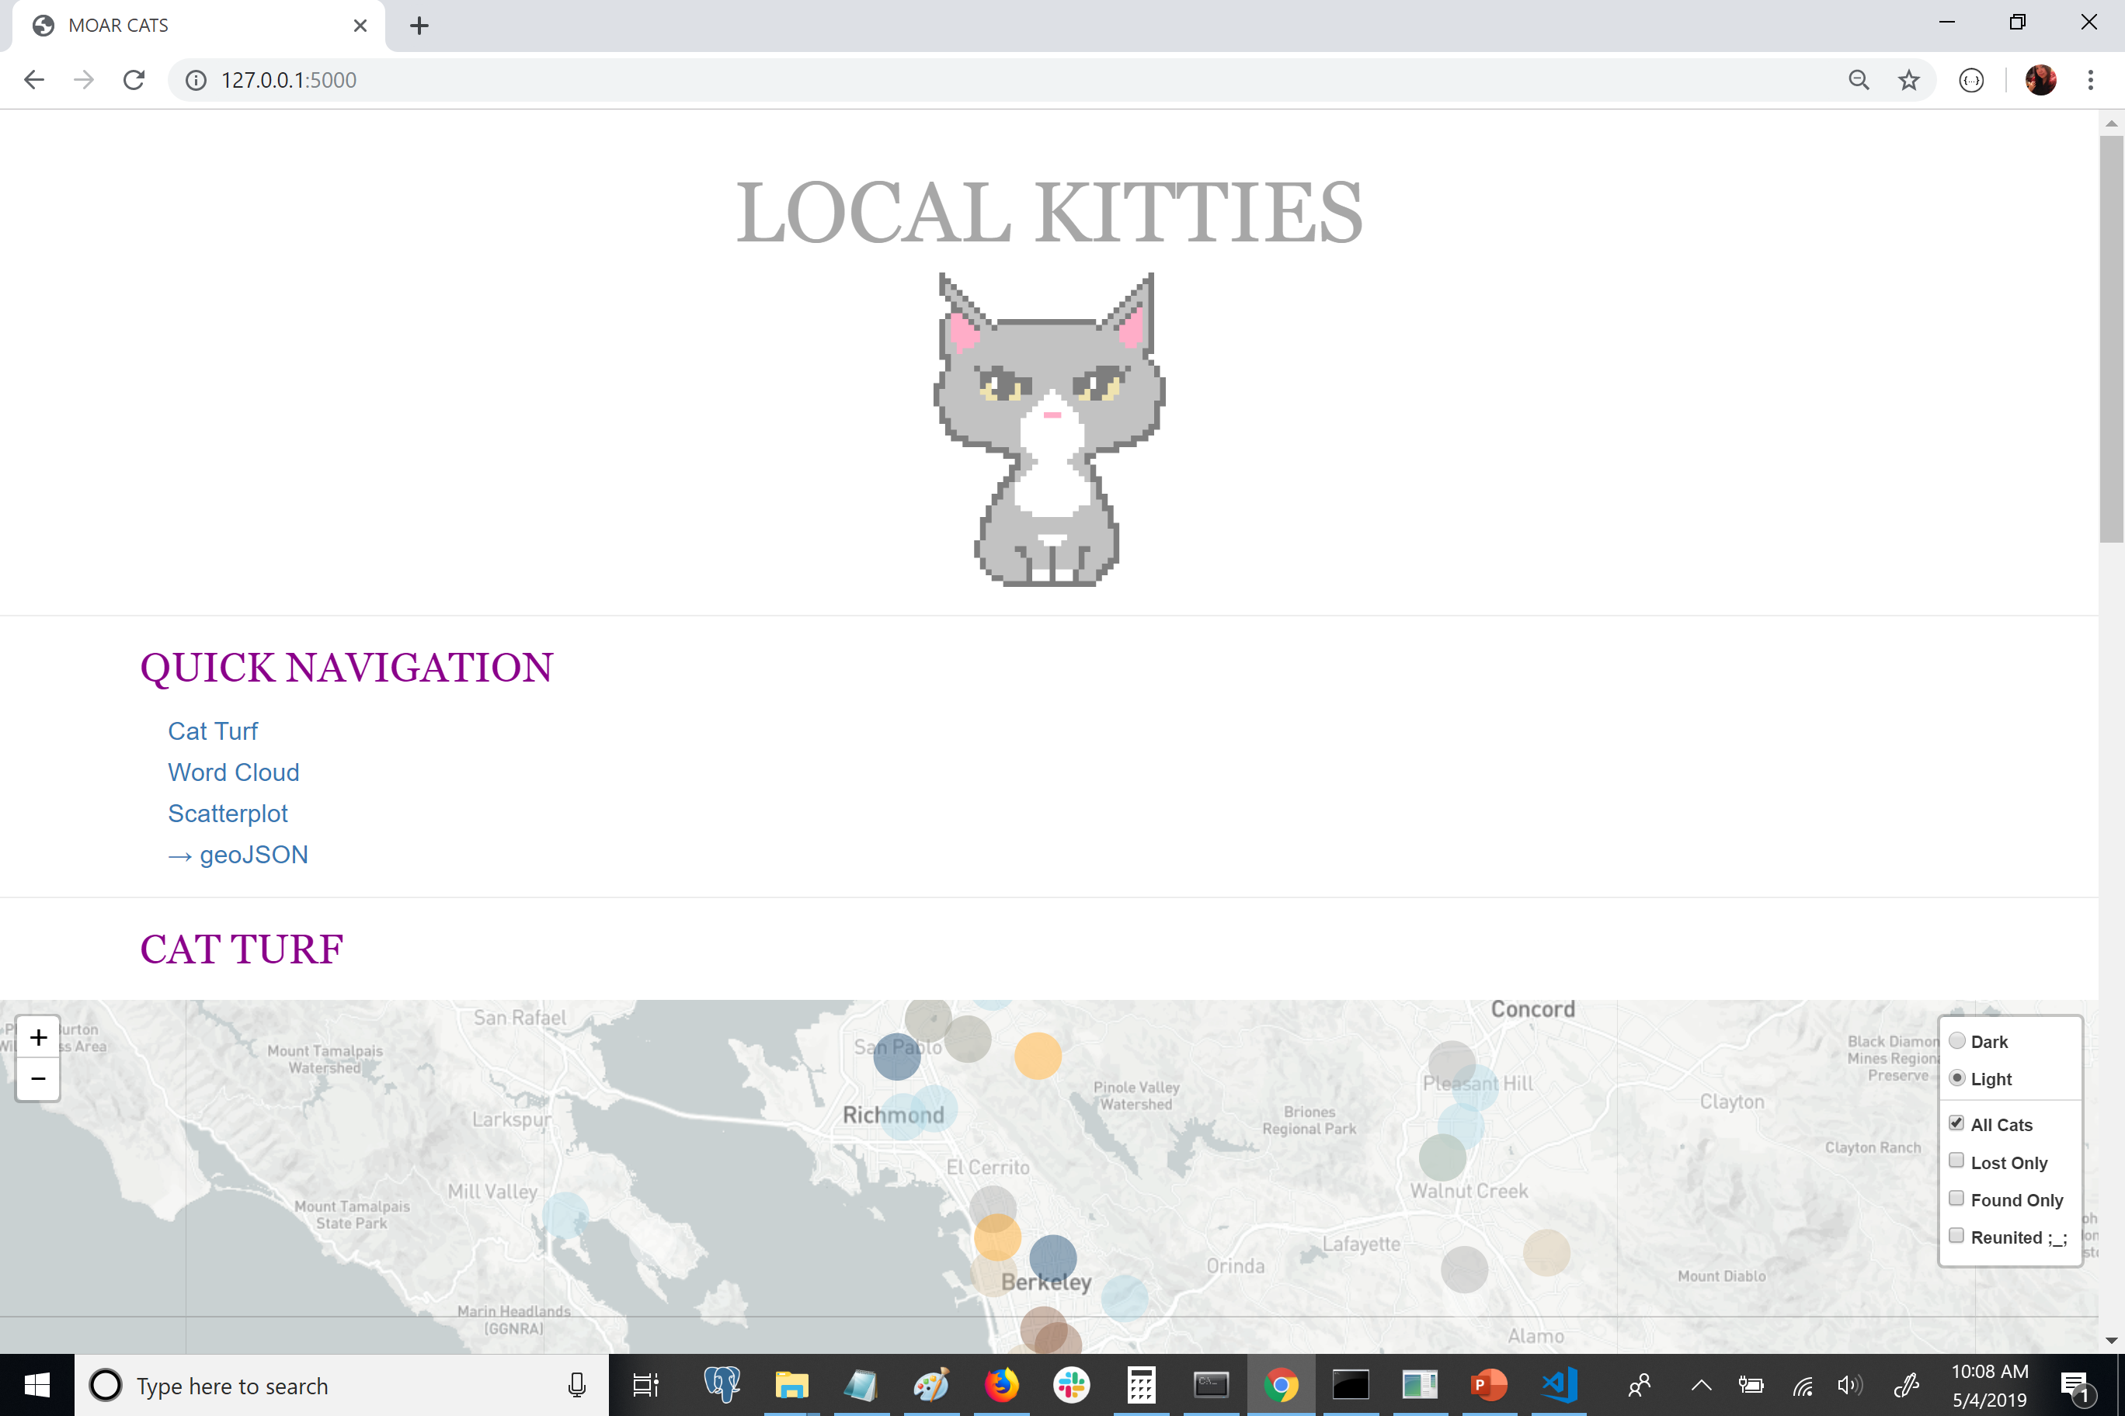

Slide 13
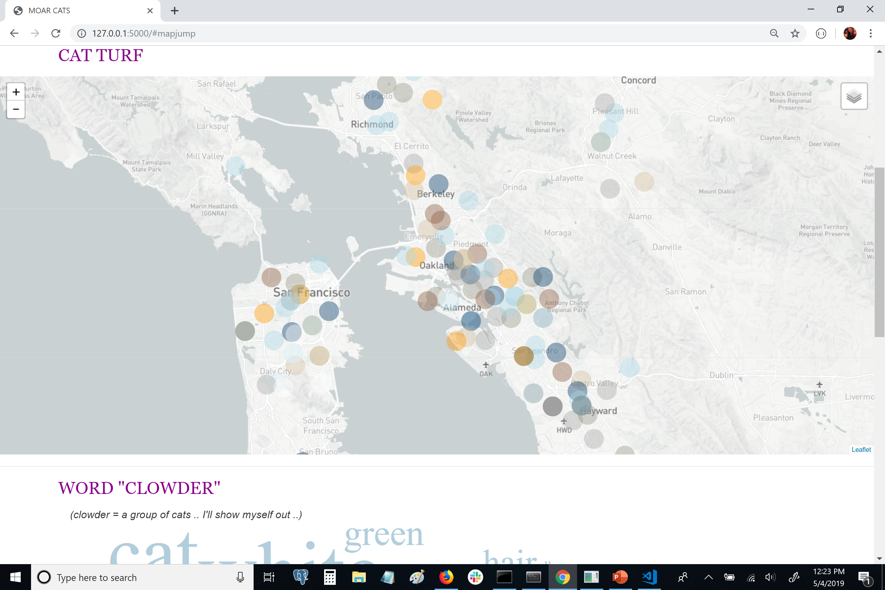

Slide 14
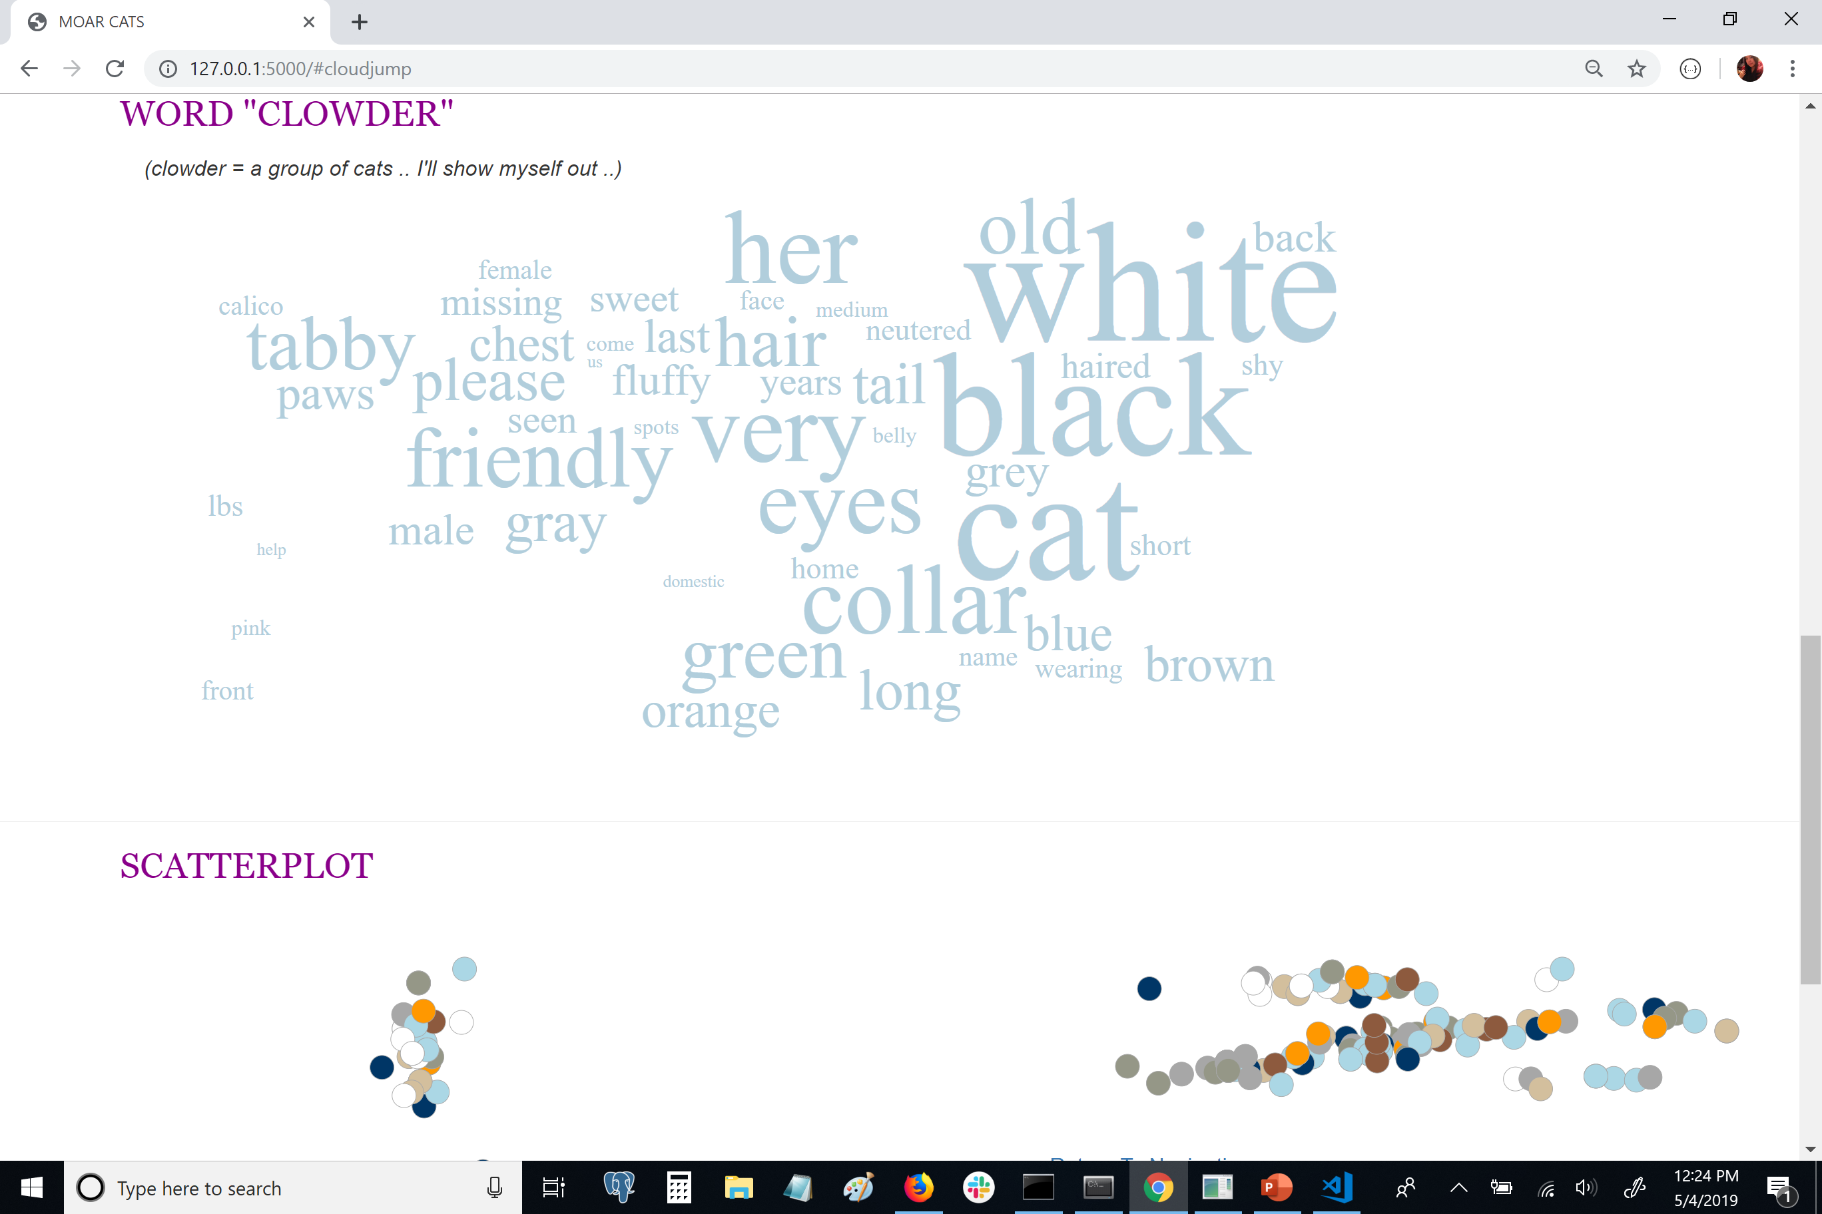

Slide 15
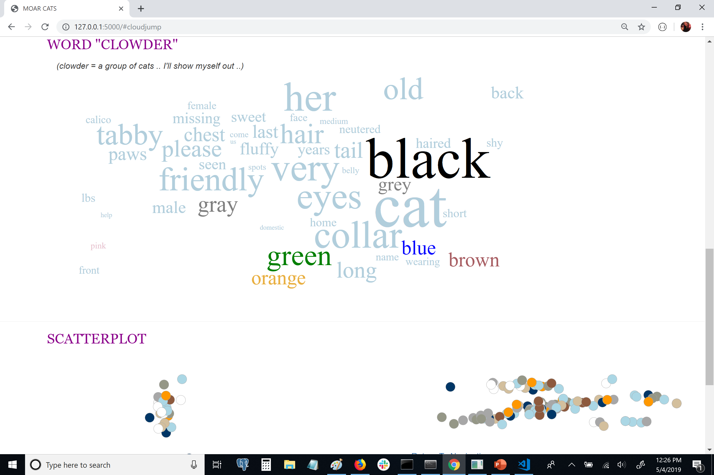

Slide 16
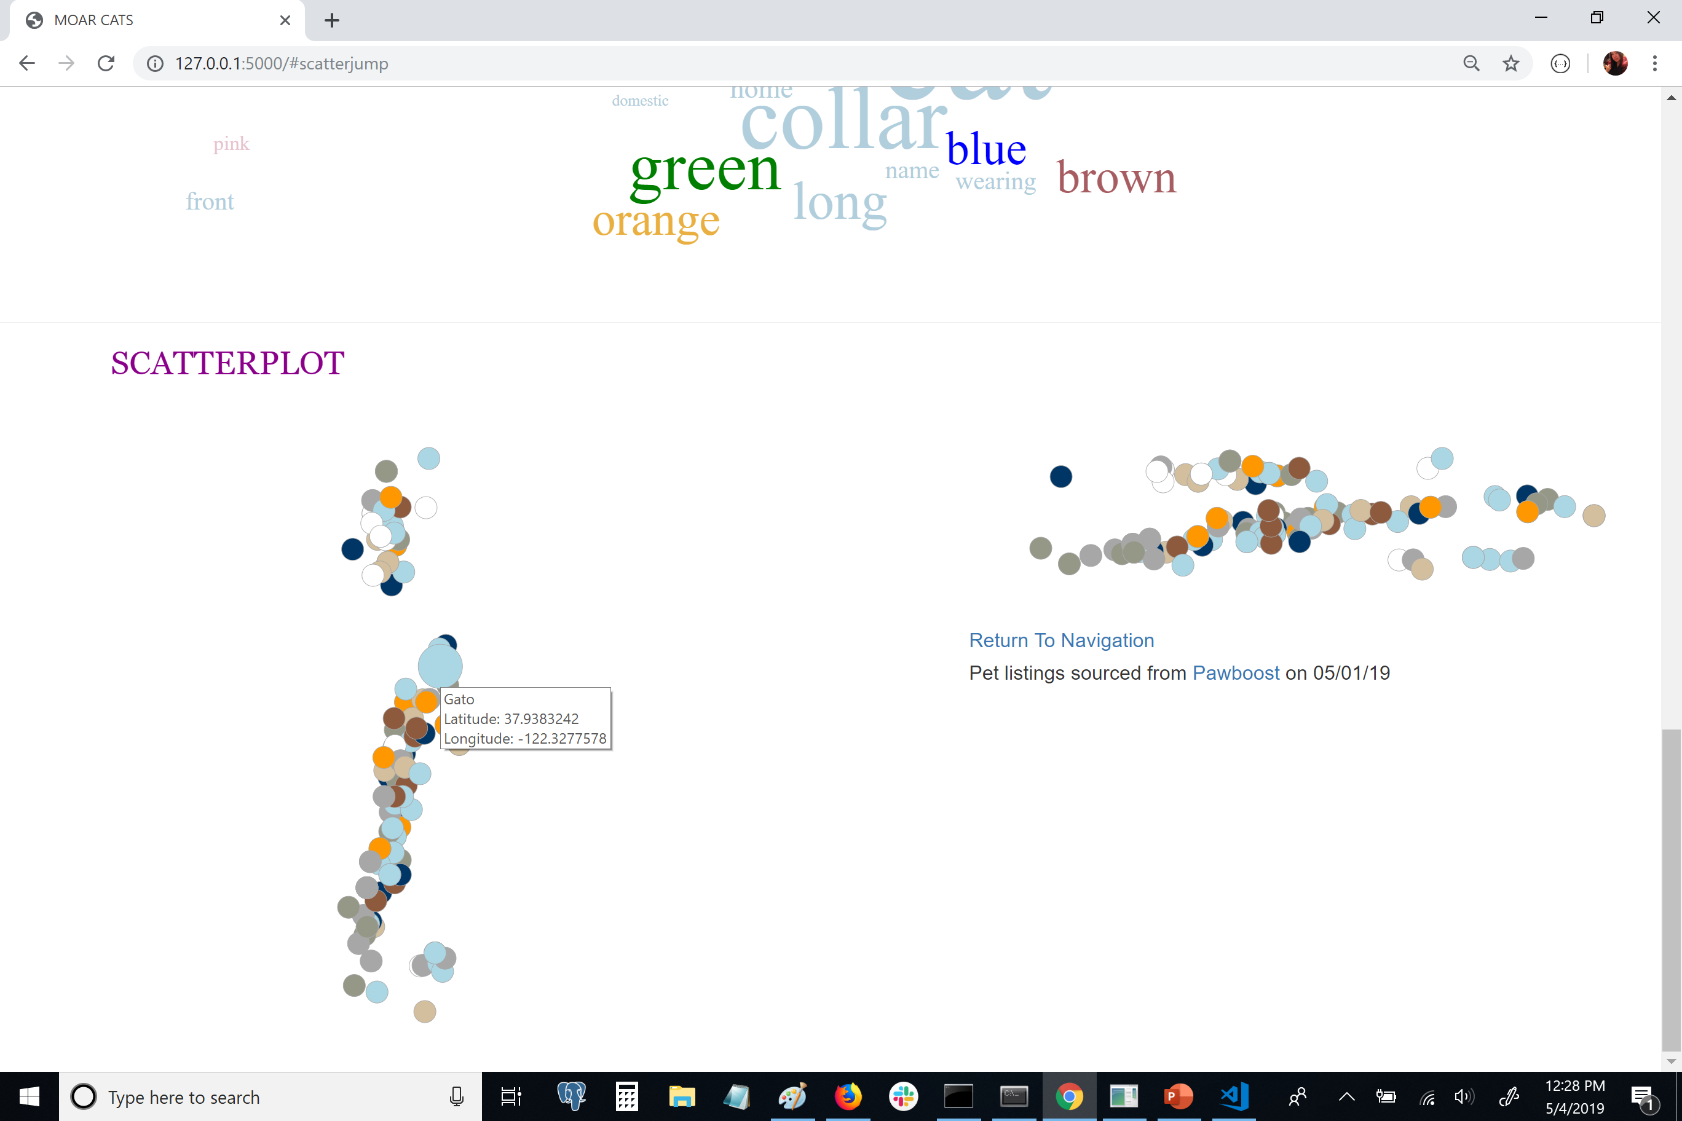

Slide 17

Closing Thoughts
Findings:
Spread of cat coat colors/patterns
Should have pulled more data
Cats versus dogs?
Regional differences?

